Slide 1
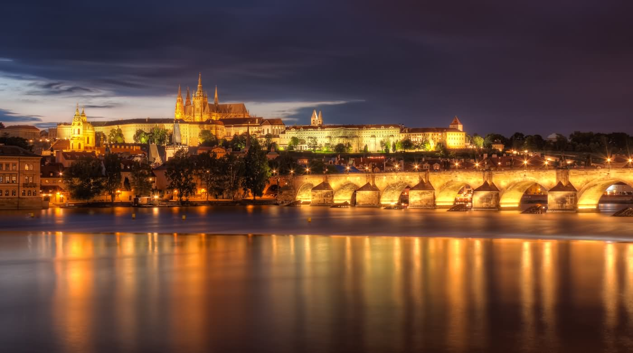



Centrally managed users
for consortia with a network zone
Yoel Kortick. Senior Librarian
https://www.askideas.com/20-amazing-sunset-view-pictures-and-images-of-charles-bridge/

Slide 2
Introduction
Introduction
Prerequisites
An example using loan
An example using request

Slide 3
Introduction
For consortia with a network zone it is possible manage users in the network zone and distribute them to member institutions.
The user record at the member institution is automatically retrieved from the Network Zone when required, for example:
  When loaning to the patron
  When placing a request for the patron
  When the patron logs in using an external IdP (identity provider)

Slide 4
Introduction
User roles are applied using the role assignment rules and are not distributed.
Local segments (email address, phone numbers etc.) can still be managed at the member institutions
When the SIS is run in the network the update process updates existing records at each member institution, but it does not create a new record for a user that does not exist in a member institution.

Slide 5
Introduction
If the user record does not yet exist in the member institution then it is automatically retrieved from the Network Zone and created in the member institution when required, for example:
  When loaning to the patron
  When placing a request for the patron
  When the patron logs in using an external IdP (identity provider)

Slide 6



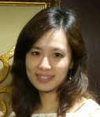


Introduction
Network Zone
ID=AliciaC613
Institution A
Institution B
Institution C

Slide 7
Introduction
Introduction
Prerequisites
An example using loan
An example using request

Slide 8
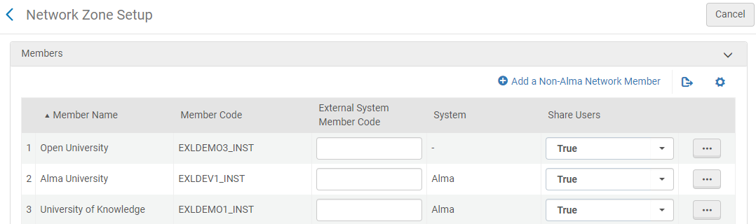
Prerequisites
To set up this functionality in the Network zone define “Configuration > General > Collaborative > Networks > Network Zone Setup” so that the member institutions are defined as “Share Users = True”

Slide 9
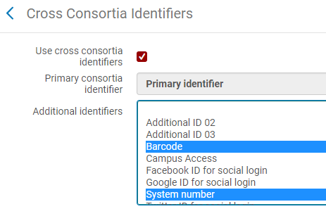
Prerequisites
Notify Ex Libris of the desired cross-consortia identifiers

Slide 10
Introduction
Introduction
Prerequisites
An example using loan
An example using request

Slide 11
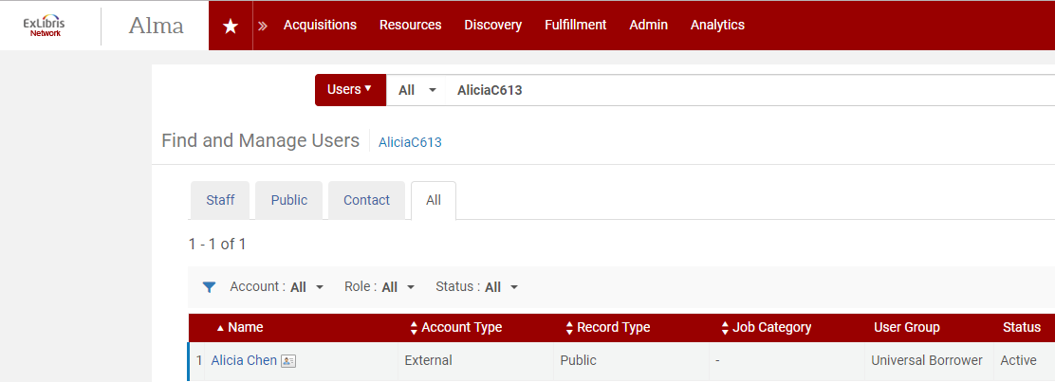
An example using loan
User Alicia Chen identifier AliciaC613 exists in the network zone and not in the member institution “Alma University”
Here we see she is in the network institution
Network

Slide 12
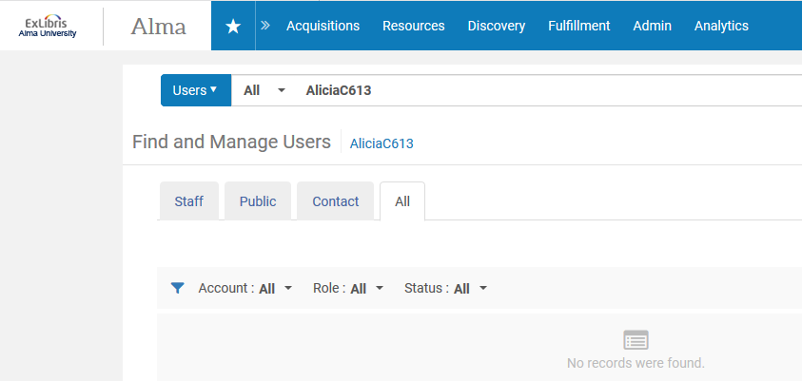
An example using loan
User Alicia Chen identifier AliciaC613 exists in the network zone and not in the member institution “Alma University”
Here we see she is not in the member institution
Member

Slide 13
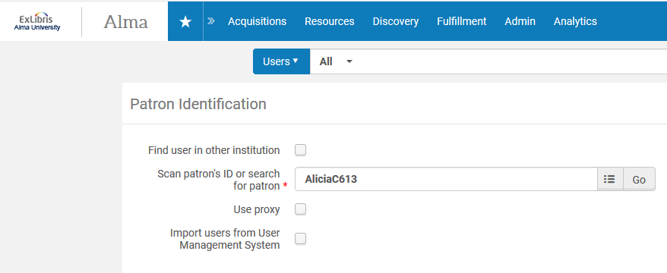
An example using loan
Now in member institution ‘Alma University’ we will perform a loan to user Alicia Chen identifier AliciaC613.
Member institution where Alicia does not exist

Slide 14
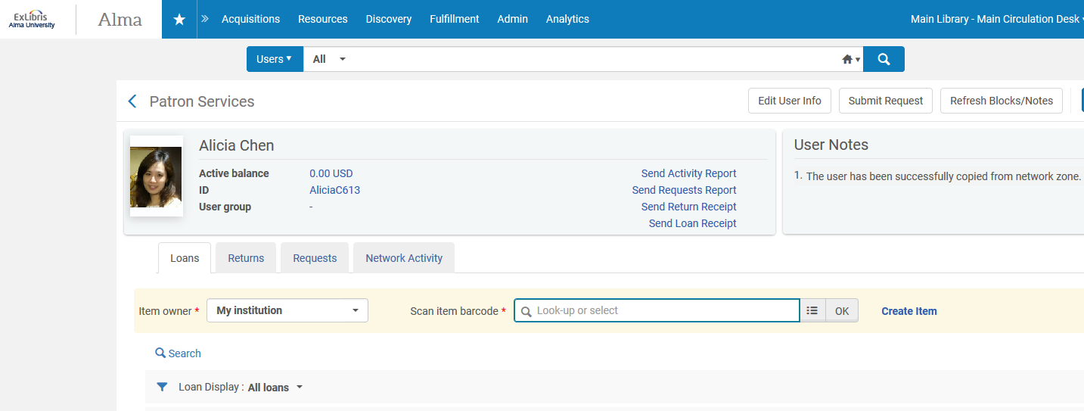
An example using loan
User is created in Alma University
Previously Alicia did not exist in member Alma University.
Note specifying that Alicia was copied from the network zone.

Slide 15
Introduction
Introduction
Prerequisites
An example using loan
An example using request

Slide 16
An example using request
As in the previous case when using a loan …
User Alicia Chen identifier AliciaC613 exists in the network zone and not in the member institution “Alma University”
Here we see she is in the network institution
Network

Slide 17
An example using request
As in the previous case when using a loan …
User Alicia Chen identifier AliciaC613 exists in the network zone and not in the member institution “Alma University”
Here we see she is not in the member institution
Member

Slide 18
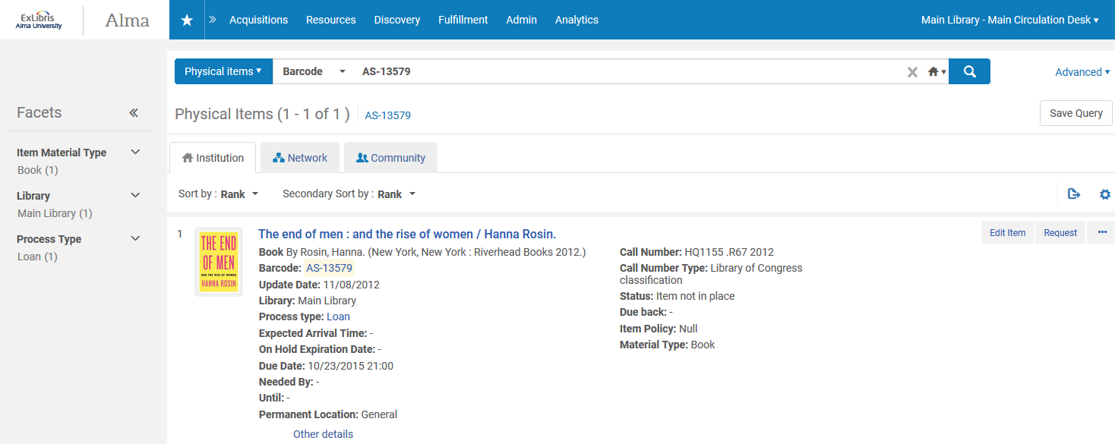
An example using request
In member institution “Alma University” barcode AS-13579 is on loan and a request will be made on it
Member

Slide 19
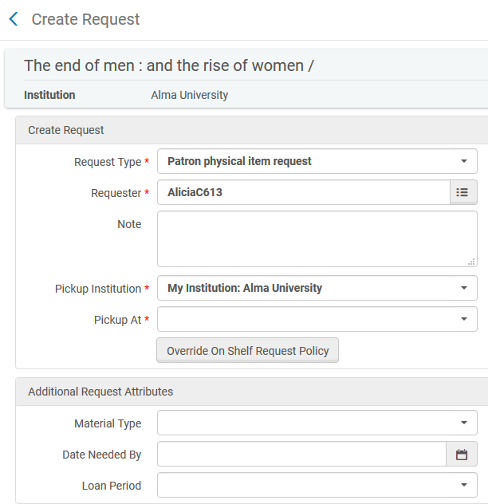
An example using request
We will add enter the patron ID and ‘enter’

Slide 20
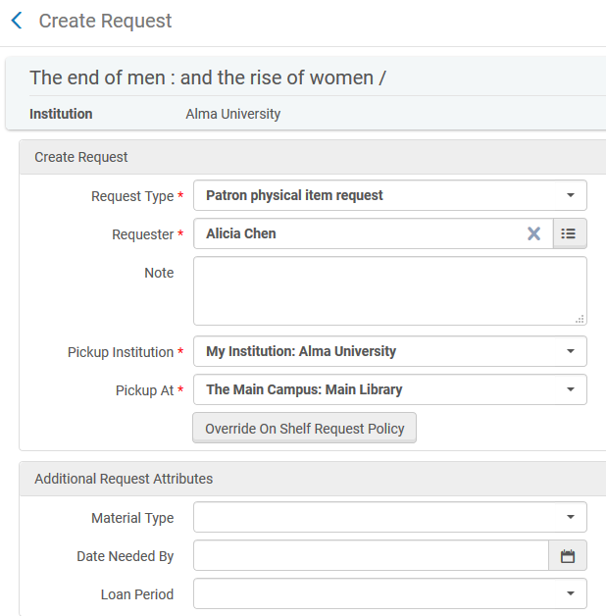
An example using request
The patron is retrieved from the network and created in the institution
Based on the user group of the patron (and fulfillment unit rule) the pickup location can be chosen

Slide 21
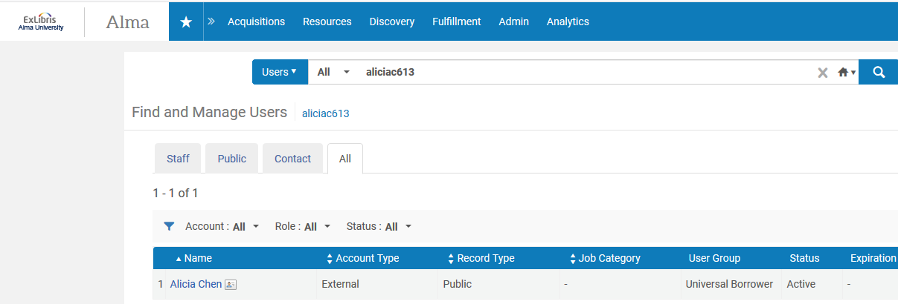
An example using request
The patron now exists in the member

Slide 22
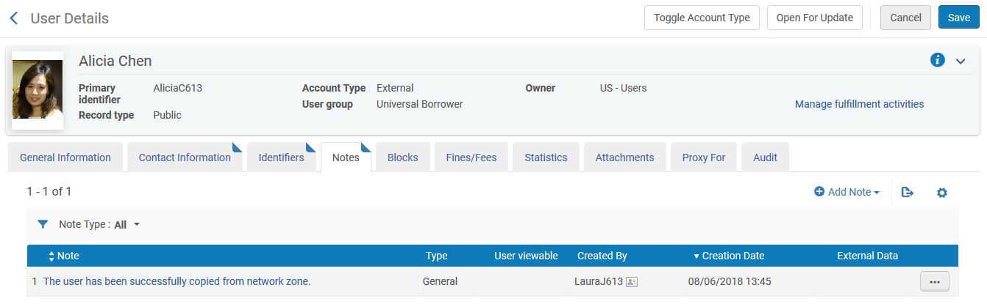
An example using request
The patron in the member has a note specifying that it was copied from the network

Slide 23
Thank You
Yoel.Kortick@exlibrisgroup.com
https://www.askideas.com/20-amazing-sunset-view-pictures-and-images-of-charles-bridge/

